Slide 1



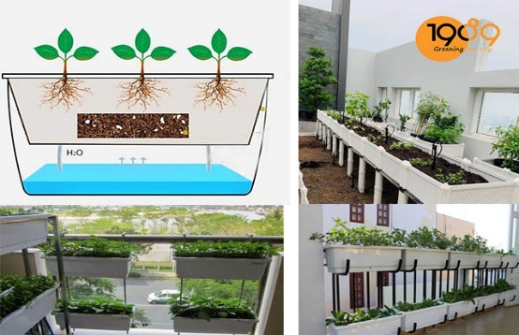
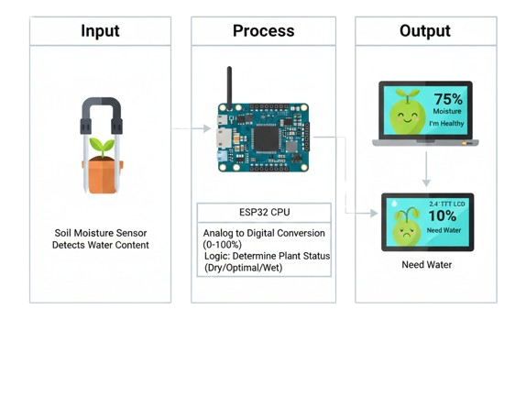
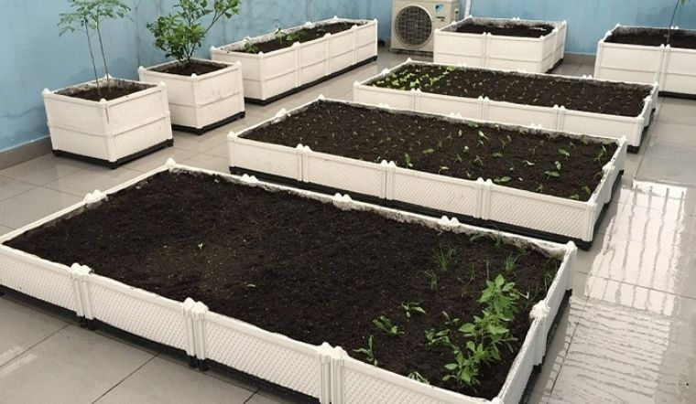
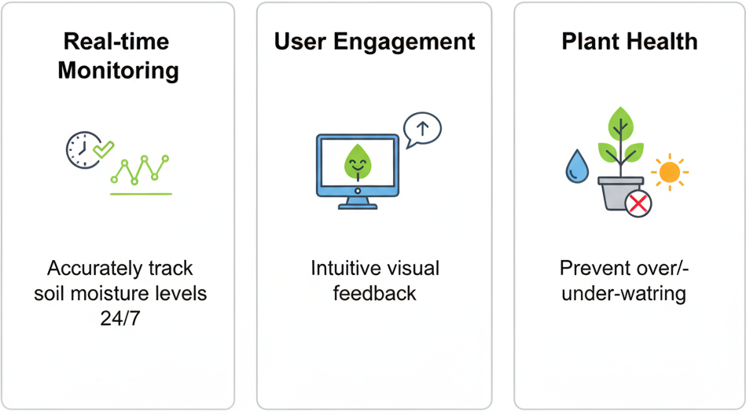
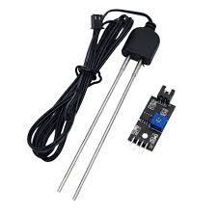
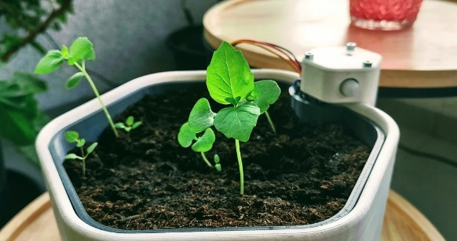
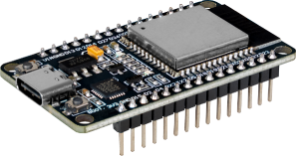
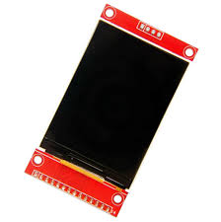
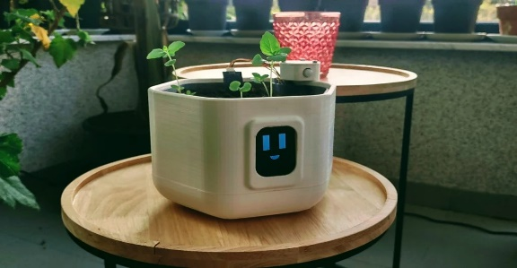
Successfully achieved high-precision monitoring with instant cloud synchronization and local display alerts.
Tuấn Dũng
Smart Plant Pot
I. Idea
III. System Architecture
Concept: A smart, interactive gardening solution that eliminates the guesswork in plant care.
Core Technology: An ESP32-based system that monitors soil health and provides "emotional" visual feedback through a 2.4-inch TFT animated display.
II. Objectives
Input: Soil Moisture Sensor detects the dielectric constant of the soil to measure water content.
Process: ESP32 CPU converts analog signals to percentage values and determines the plant's "mood" (Dry/Optimal/Wet).
Output: * Visual: 2.4" TFT LCD displays real-time percentages and animated icons.
Feedback: Dynamic status messages (e.g., "Need Water", "I'm Healthy").
Real-time Monitoring: Accurately track soil moisture levels 24/7.
User Engagement: Use intuitive animations to simplify technical data for the user.
Plant Health: Prevent root rot from overwatering and dehydration from underwatering.
IV. Innovation
V. Results
Visual Intelligence: Replaces boring numbers with engaging animations, making technology more "human."
Edge Processing: Instant sensor-to-screen response without needing an external server.
Future-Ready: Designed for easy expansion into automatic irrigation (water pump) and mobile app sync.
Successfully created a responsive, real-time feedback loop that simplifies plant maintenance for beginners.
Input: Multi-sensor array (MQ series + DHT22) captures environmental variables.
Process: ESP32 digitizes signals, applies calibration, and manages Wi-Fi protocols.
Output: Cloud-based dashboard on ThingSpeak for real-time monitoring and a analysis.
Thiết bị này sử dụng loại bức xạ điện từ nào?
Đặc điểm của nó là gì?
Low Cost: High performance at a fraction of the price of industrial meters.
Smart Calibration: Automatic temperature compensation for stable readings.
Versatility: Scalable for home use, aquaculture, and environmental protection.

